Slide 1
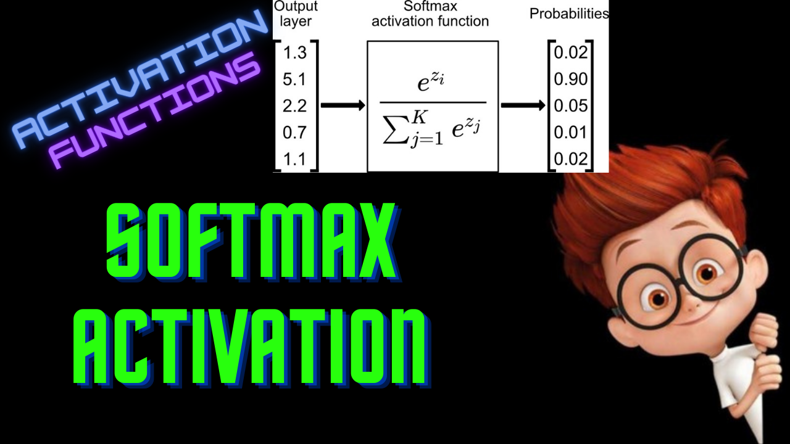

Slide 2
Softmax Activation
ML For Nerds

Slide 3
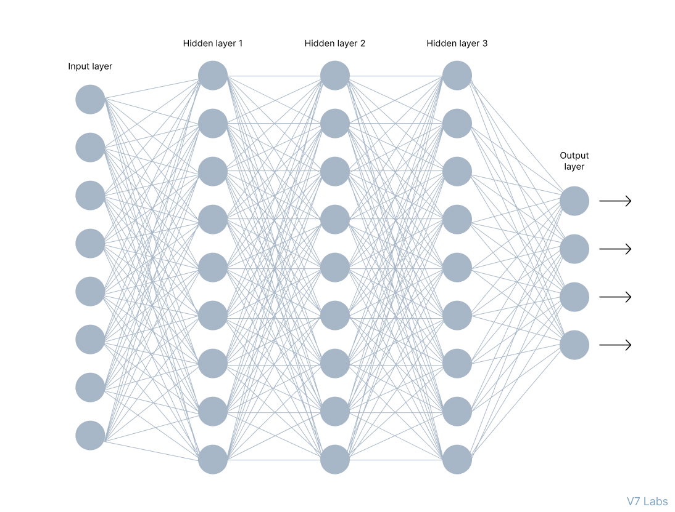
Multi-class classification

Slide 4
Requirements
Range - [0,1]
Sum of outputs = 1

Slide 5
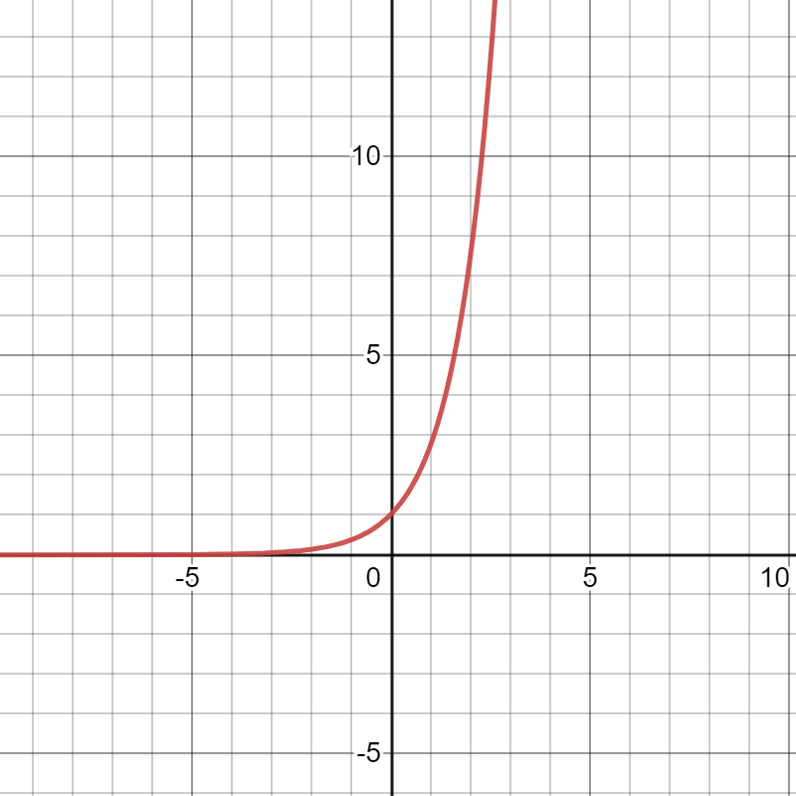
exp
X | -inf | 0 | inf
exp(x) | 0 | 1 | inf

Slide 6
2
3
5
1

Slide 7
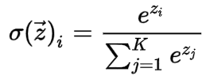
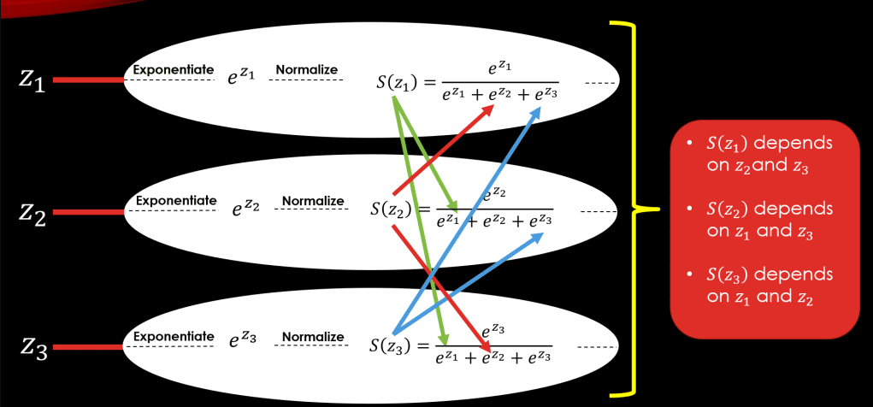
K - number of classes

Slide 8












Derivative
Z1
Z2
Z3

Slide 9



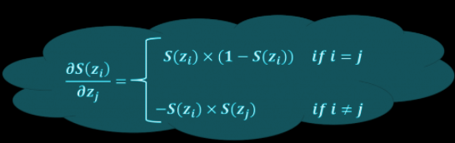
Derivative

Slide 10
Drawbacks
Computationally expensive
Used for only output layers
Vanishing Gradient
Not 0-centered function

Slide 11
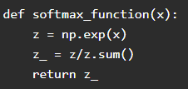
Python Implementation

